Slide 1
EMS702UP Statistical Thinking and Applied Machine Learning
W5.1-5.2 Fuzzy Rule Based System and Its Operations
Jun Chen

Slide 2
Fuzzy Rule Based Systems
In any type of fuzzy logic systems, fuzzy rules using linguistic variables have to be built. These represent the ‘knowledge’ about the process under investigation. There is more than one type of fuzzy rule-based systems, but the two most popular ones are:
Mamdani-type fuzzy rule base
Sugeno-type fuzzy rule base

Slide 3
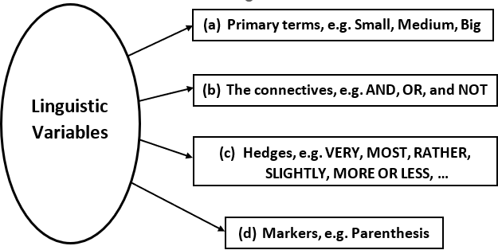
Fuzzy Rule Based Systems – Linguistic Variables and Hedges
If fuzzy logic operates with words and terms of natural language, why all these mathematical formulas?
Because fuzzy sets theory allows for modelling of terms of natural language with the help of linguistic variables.
Linguistic variables consist of the following:

Slide 4
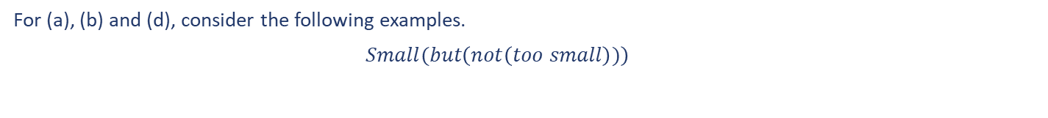
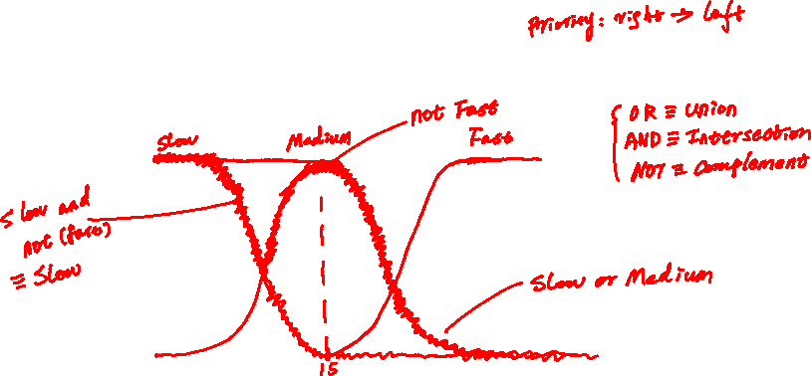
Fuzzy Rule Based Systems – Linguistic Variables and Hedges
For (a), (b) and (d), consider the following examples.
$$Small(but\left(not\left(too small\right))\right)$$
For the linguistic variables, ‘Slow’, ‘Medium’ and ‘Fast’, given in the graph below, express ‘Slow OR Medium’, ‘Slow AND NOT (Fast)’

Slide 5
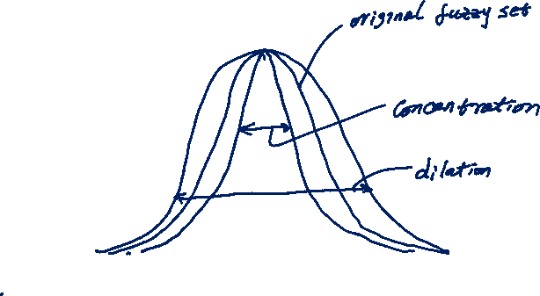
Fuzzy Rule Based Systems – Linguistic Variables and Hedges
For (c), hedges are applied on primary terms to realise 4 (strictly speaking 3) processes.
Intensification or Concentration
Dilation
Fuzzification

Slide 6
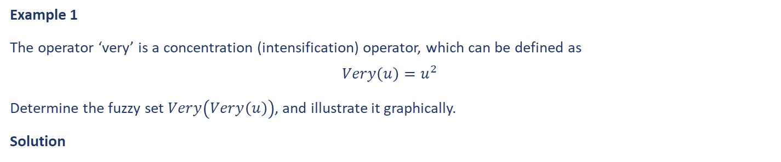

Fuzzy Rule Based Systems – Linguistic Variables and Hedges
Example 1
The operator ‘very’ is a concentration (intensification) operator, which can be defined as
$$Very\left(u\right)=u^{2}$$
Determine the fuzzy set $Very\left(Very\left(u\right)\right)$, and illustrate it graphically.
Solution

Slide 7
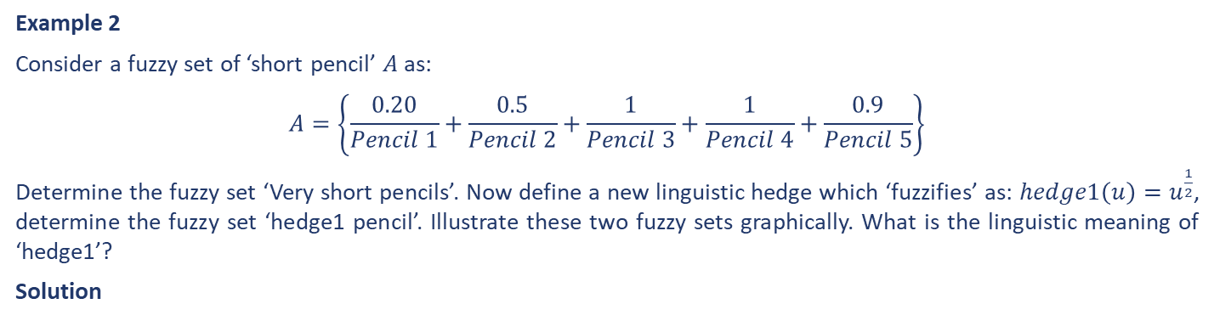
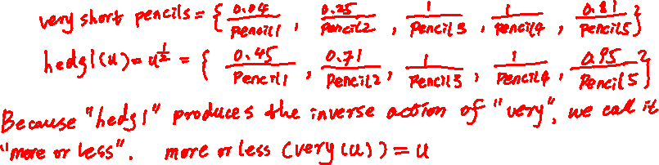
Fuzzy Rule Based Systems – Linguistic Variables and Hedges
Example 2
Consider a fuzzy set of ‘short pencil’ $A$ as:
$$A=\left\{\frac{0.20}{Pencil 1}+\frac{0.5}{Pencil 2}+\frac{1}{Pencil 3}+\frac{1}{Pencil 4}+\frac{0.9}{Pencil 5}\right\}$$
Determine the fuzzy set ‘Very short pencils’. Now define a new linguistic hedge which ‘fuzzifies’ as: $hedge1\left(u\right)=u^{\frac{1}{2}}$, determine the fuzzy set ‘hedge1 pencil’. Illustrate these two fuzzy sets graphically. What is the linguistic meaning of ‘hedge1’?
Solution

Slide 8
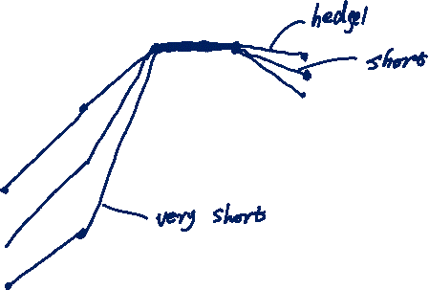
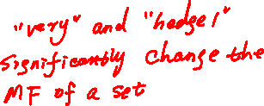

Fuzzy Rule Based Systems – Linguistic Variables and Hedges
Example 2 Continued…
Solution

Slide 9
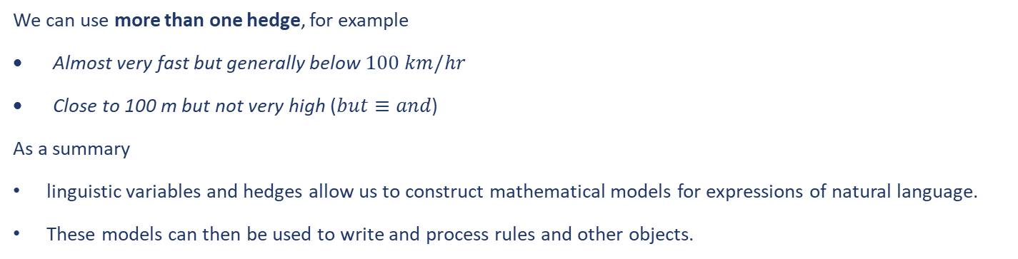

Fuzzy Rule Based Systems – Linguistic Variables and Hedges
We can use more than one hedge, for example
Almost very fast but generally below $100 km/hr$
Close to 100 m but not very high ($but≡and$)
As a summary
linguistic variables and hedges allow us to construct mathematical models for expressions of natural language.
These models can then be used to write and process rules and other objects.

Slide 10
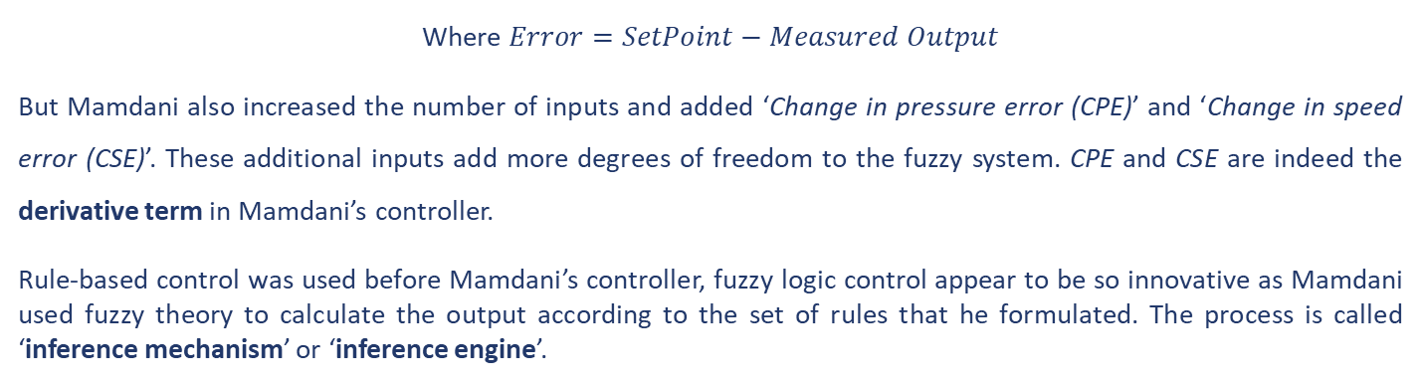
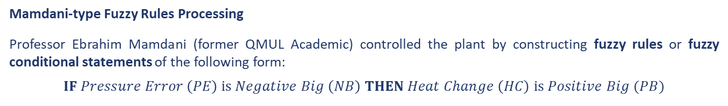
Fuzzy Rule Based Systems – Fuzzy Rules Processing
Mamdani-type Fuzzy Rules Processing
Professor Ebrahim Mamdani (former QMUL Academic) controlled the plant by constructing fuzzy rules or fuzzy conditional statements of the following form:
$$IF Pressure Error \left(PE\right) is Negative Big \left(NB\right) THEN Heat Change \left(HC\right) is Positive Big (PB)$$
Where $Error=SetPoint−Measured Output$
But Mamdani also increased the number of inputs and added ‘Change in pressure error (CPE)’ and ‘Change in speed error (CSE)’. These additional inputs add more degrees of freedom to the fuzzy system. CPE and CSE are indeed the derivative term in Mamdani’s controller.
Rule-based control was used before Mamdani’s controller, fuzzy logic control appear to be so innovative as Mamdani used fuzzy theory to calculate the output according to the set of rules that he formulated. The process is called ‘inference mechanism’ or ‘inference engine’.

Slide 11
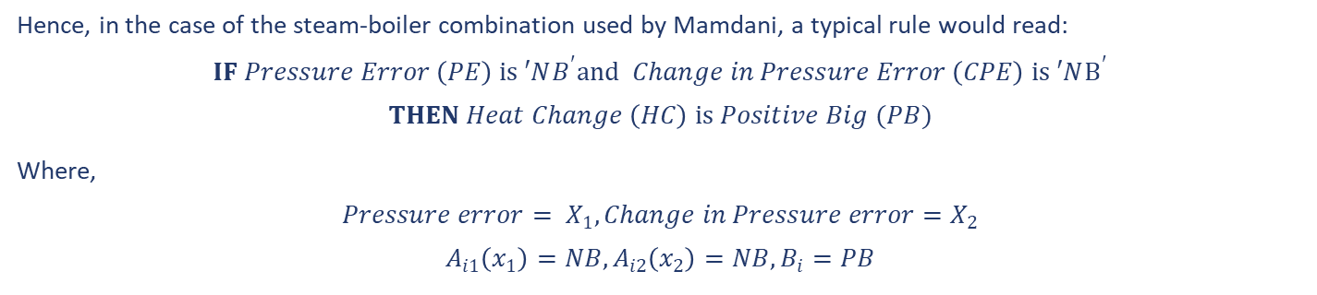

Fuzzy Rule Based Systems – Fuzzy Rules Processing
Mamdani-type Fuzzy Rules Processing
Mathematically, a rule ‘a la Mamdani’ would be formulated as follows:
$$IF A_{i1}\left(x_{1}\right), A_{i2}\left(x_{2}\right),…,A_{im}\left(x_{m}\right) THEN y is B_{i}$$
Hence, in the case of the steam-boiler combination used by Mamdani, a typical rule would read:
$$IF Pressure Error \left(PE\right) is ′NB^{′}and Change in Pressure Error \left(CPE\right) is ′NB^{′}$$
$$THEN Heat Change \left(HC\right) is Positive Big (PB)$$
Where,
$$Pressure error= X_{1}, Change in Pressure error=X_{2}$$
$$A_{i1}\left(x_{1}\right)=NB, A_{i2}\left(x_{2}\right)=NB, B_{i}=PB$$

Slide 12
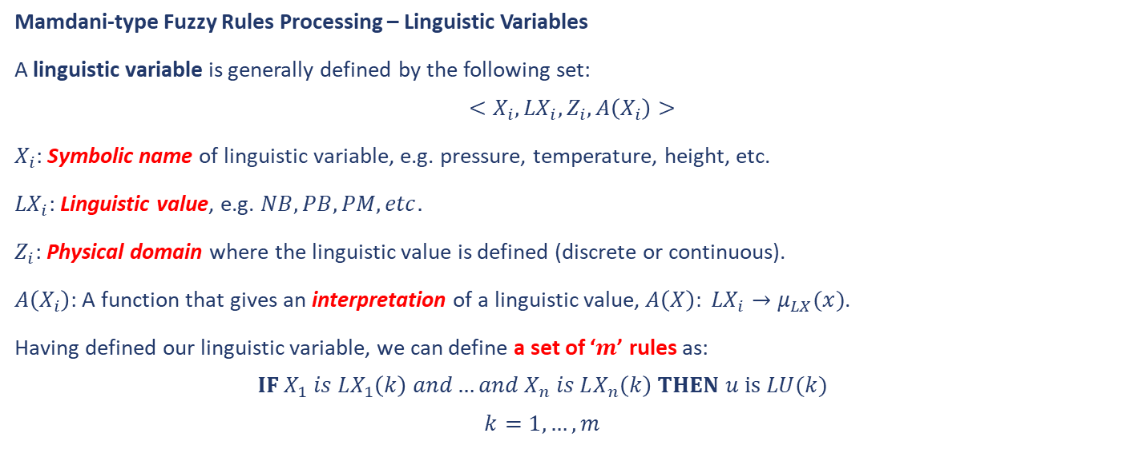
Fuzzy Rule Based Systems – Fuzzy Rules Processing
Mamdani-type Fuzzy Rules Processing – Linguistic Variables
A linguistic variable is generally defined by the following set:
$$<X_{i},{LX}_{i}, Z_{i}, A\left(X_{i}\right)>$$
$X_{i}$: Symbolic name of linguistic variable, e.g. pressure, temperature, height, etc.
${LX}_{i}$: Linguistic value, e.g. $NB, PB, PM, etc.$
$Z_{i}$: Physical domain where the linguistic value is defined (discrete or continuous).
$A\left(X_{i}\right)$: A function that gives an interpretation of a linguistic value, $A\left(X\right): {LX}_{i}→μ_{LX}(x)$.
Having defined our linguistic variable, we can define a set of ‘$m$’ rules as:
$$IF X_{1} is LX_{1}\left(k\right) and…and X_{n} is LX_{n}\left(k\right) THEN u is LU(k)$$
$$k=1,…,m$$

Slide 13
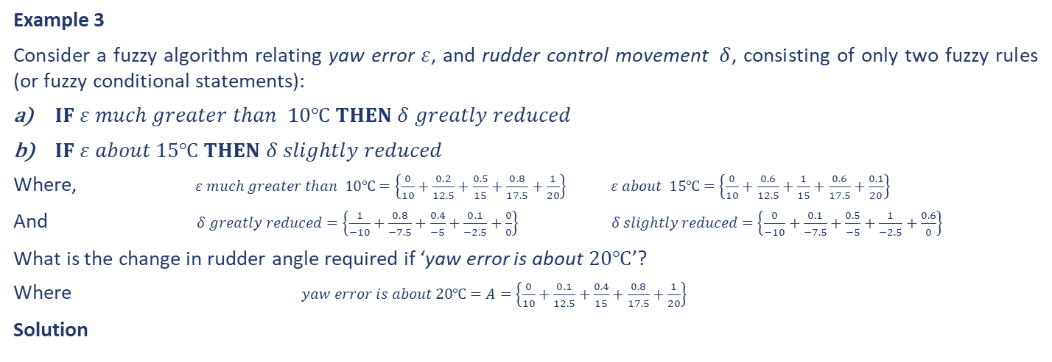

Fuzzy Rule Based Systems – Fuzzy Rules Processing
Mamdani-type Fuzzy Rules Processing – Inference Mechanism
There are two techniques of inference mechanism, i.e. analytical and graphical (rule firing).
Analytical Technique of Inference
Example 3
Consider a fuzzy algorithm relating yaw error $ε$, and rudder control movement $δ$, consisting of only two fuzzy rules (or fuzzy conditional statements):
$IF ε much greater than 10℃ THEN δ greatly reduced$
$IF ε about 15℃ THEN δ slightly reduced$
Where, $ε much greater than 10℃=\left\{\frac{0}{10}+\frac{0.2}{12.5}+\frac{0.5}{15}+\frac{0.8}{17.5}+\frac{1}{20}\right\} ε about 15℃=\left\{\frac{0}{10}+\frac{0.6}{12.5}+\frac{1}{15}+\frac{0.6}{17.5}+\frac{0.1}{20}\right\}$
And $δ greatly reduced=\left\{\frac{1}{−10}+\frac{0.8}{−7.5}+\frac{0.4}{−5}+\frac{0.1}{−2.5}+\frac{0}{0}\right\} δ slightly reduced=\left\{\frac{0}{−10}+\frac{0.1}{−7.5}+\frac{0.5}{−5}+\frac{1}{−2.5}+\frac{0.6}{0}\right\}$
What is the change in rudder angle required if ‘yaw error is about $20℃$’?
Where $yaw error is about 20℃=A=\left\{\frac{0}{10}+\frac{0.1}{12.5}+\frac{0.4}{15}+\frac{0.8}{17.5}+\frac{1}{20}\right\}$
Solution

Slide 14
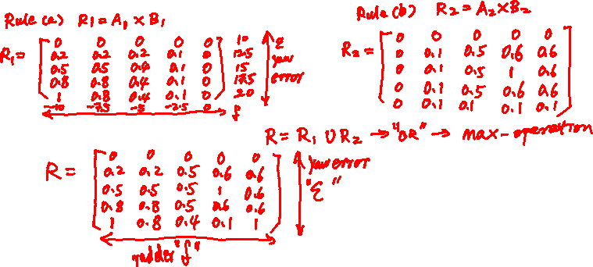
Fuzzy Rule Based Systems – Fuzzy Rules Processing
Analytical Technique of Inference
Example 3 Continued…
Solution
Step 1: Calculate the relational Matric for each rule
Step 2: Calculate the overall relational matrix

Slide 15
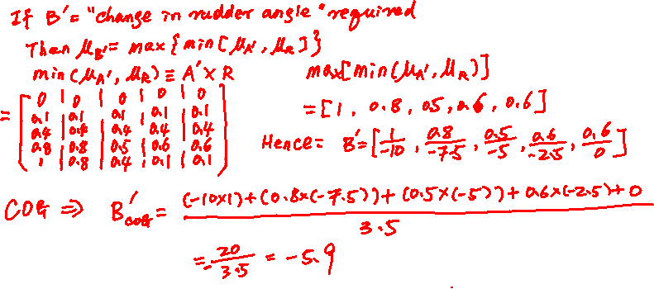
Fuzzy Rule Based Systems – Fuzzy Rules Processing
Analytical Technique of Inference
Example 3 Continued…
Solution
Step 3: Use the composition rule of inference to find the change in rudder angle given the yaw error
Step 4: Defuzzify the output membership function to obtain the crisp value of the change in rudder angle

Slide 16
Fuzzy Rule Based Systems – Fuzzy Rules Processing
Analytical Technique of Inference
The obvious drawbacks associated with the analytical method is it is computationally expensive;
Especially when the number of rules + number of antecedents and consequents increases (multivariable case);
In such a case, we will need the approach of ‘firing the rules’, which can be illustrated graphically through the following example.

Slide 17
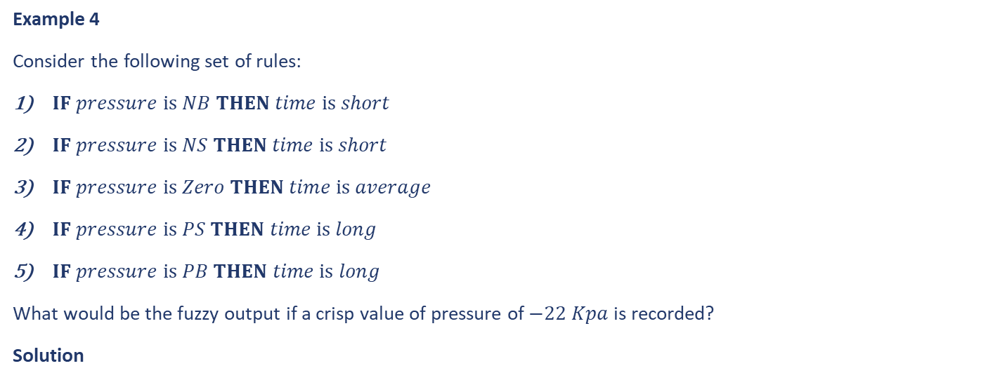
Fuzzy Rule Based Systems – Fuzzy Rules Processing
Graphical Technique of Inference
Example 4
Consider the following set of rules:
$IF pressure is NB THEN time is short$
$IF pressure is NS THEN time is short$
$IF pressure is Zero THEN time is average$
$IF pressure is PS THEN time is long$
$IF pressure is PB THEN time is long$
What would be the fuzzy output if a crisp value of pressure of $−22 Kpa$ is recorded?
Solution

Slide 18
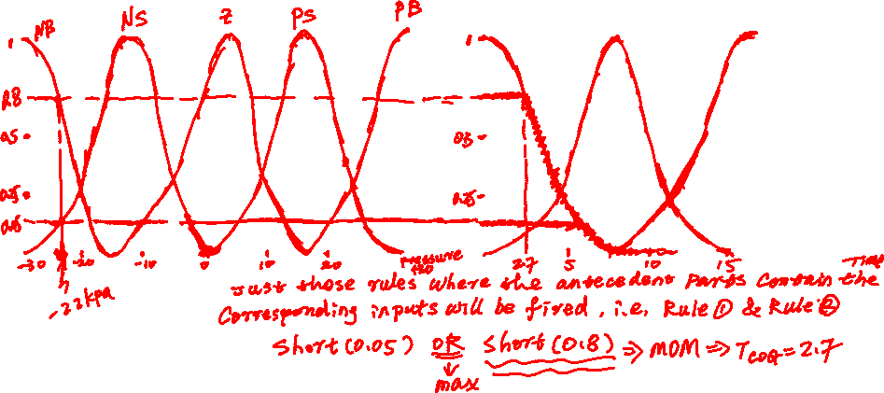
Fuzzy Rule Based Systems – Fuzzy Rules Processing
Graphical Technique of Inference
Example 4 Continued…

Slide 19
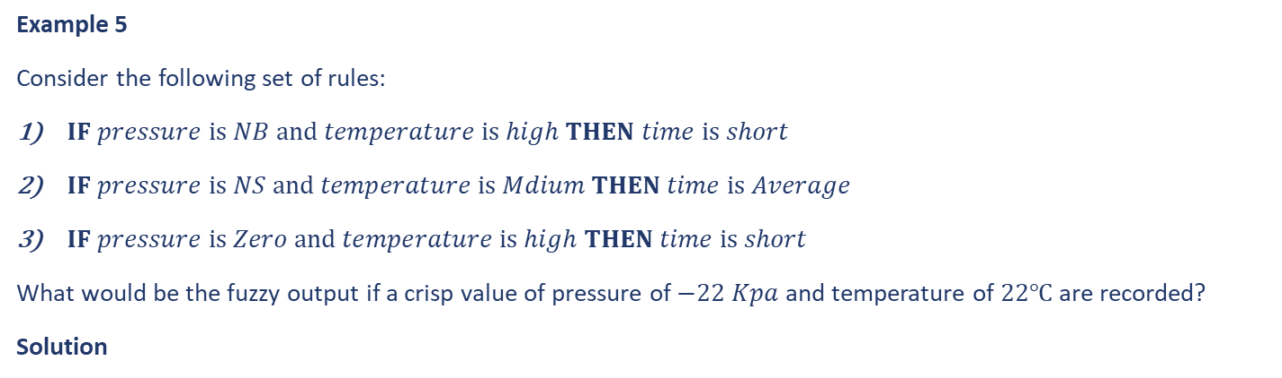
Fuzzy Rule Based Systems – Fuzzy Rules Processing
Graphical Technique of Inference
The reason we need to fire the rules is to execute the mapping between the fuzzy input and fuzzy output, in other words we need to transform the membership degree from the antecedent part to the consequent part.
Example 5
Consider the following set of rules:
$IF pressure is NB and temperature is high THEN time is short$
$IF pressure is NS and temperature is Mdium THEN time is Average$
$IF pressure is Zero and temperature is high THEN time is short$
What would be the fuzzy output if a crisp value of pressure of $−22 Kpa$ and temperature of $22℃$ are recorded?
Solution

Slide 20
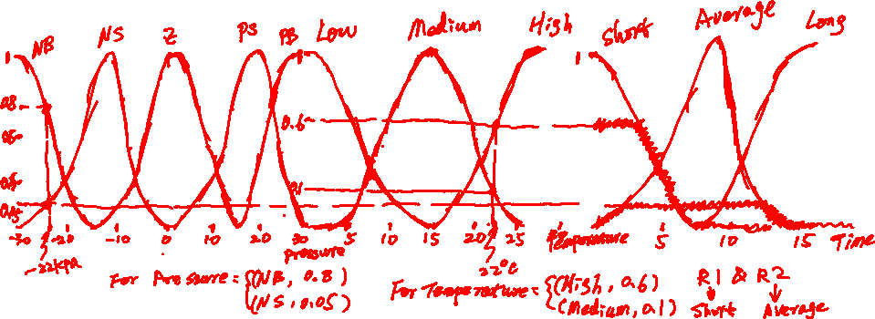
Fuzzy Rule Based Systems – Fuzzy Rules Processing
Graphical Technique of Inference
Example 5 Continued…
Solution

Slide 21
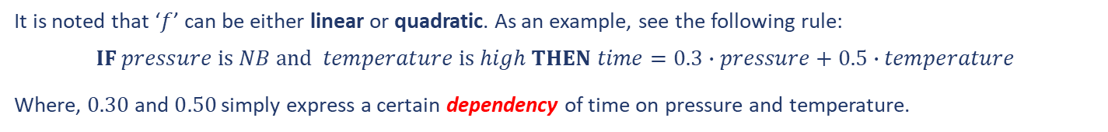
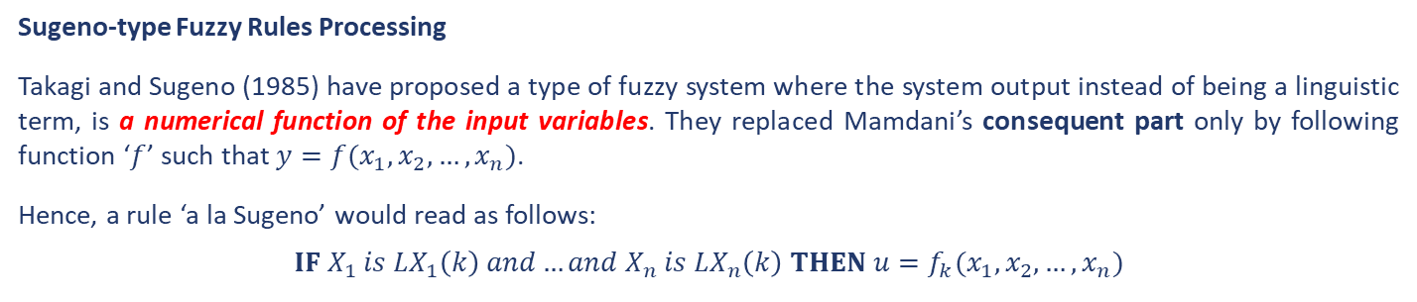
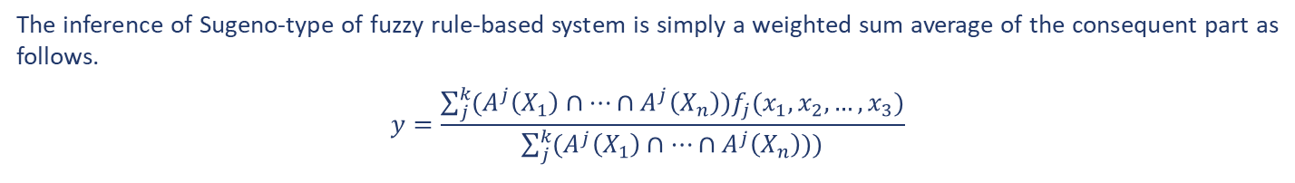
Fuzzy Rule Based Systems – Fuzzy Rules Processing
Sugeno-type Fuzzy Rules Processing
Takagi and Sugeno (1985) have proposed a type of fuzzy system where the system output instead of being a linguistic term, is a numerical function of the input variables. They replaced Mamdani’s consequent part only by following function ‘$f$’ such that $y=f(x_{1}, x_{2},…, x_{n})$.
Hence, a rule ‘a la Sugeno’ would read as follows:
$$IF X_{1} is LX_{1}\left(k\right) and…and X_{n} is LX_{n}\left(k\right) THEN u=f_{k}(x_{1}, x_{2},…, x_{n})$$
It is noted that ‘$f$’ can be either linear or quadratic. As an example, see the following rule:
$$IF pressure is NB and temperature is high THEN time=0.3∙pressure+0.5∙temperature$$
Where, $0.30$ and $0.50$ simply express a certain dependency of time on pressure and temperature.
The inference of Sugeno-type of fuzzy rule-based system is simply a weighted sum average of the consequent part as follows.
$$y=\frac{\sum_{j}^{k}{(A^{j}\left(X_{1}\right)∩…∩A^{j}\left(X_{n}\right))f_{j}(x_{1}, x_{2},…, x_{3})}}{\sum_{j}^{k}{(A^{j}\left(X_{1}\right)∩…∩A^{j}\left(X_{n}\right)))}}$$

Slide 22
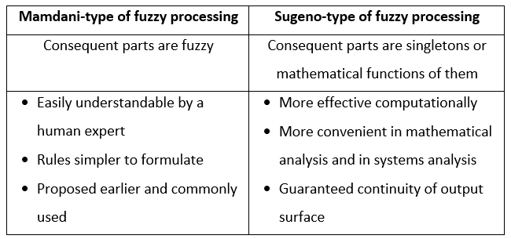

Fuzzy Rule Based Systems – Fuzzy Rules Processing
Comparison of Mamdani’s Processing to Sugeno’s Fuzzy processing

Slide 23
Fuzzy Rule Based System Operation
We have seen that the inference engine is at the heart of any fuzzy rule based system operation. In fact, fuzzy rule based system operation can be divided into three steps:
Fuzzification (inputs are fuzzified and fuzzy rather than crisp inputs are obtained).
Fuzzy Processing (processing fuzzy inputs according to rules and producing fuzzy outputs).
Defuzzification (producing a crisp real value from a fuzzy output).

Slide 24
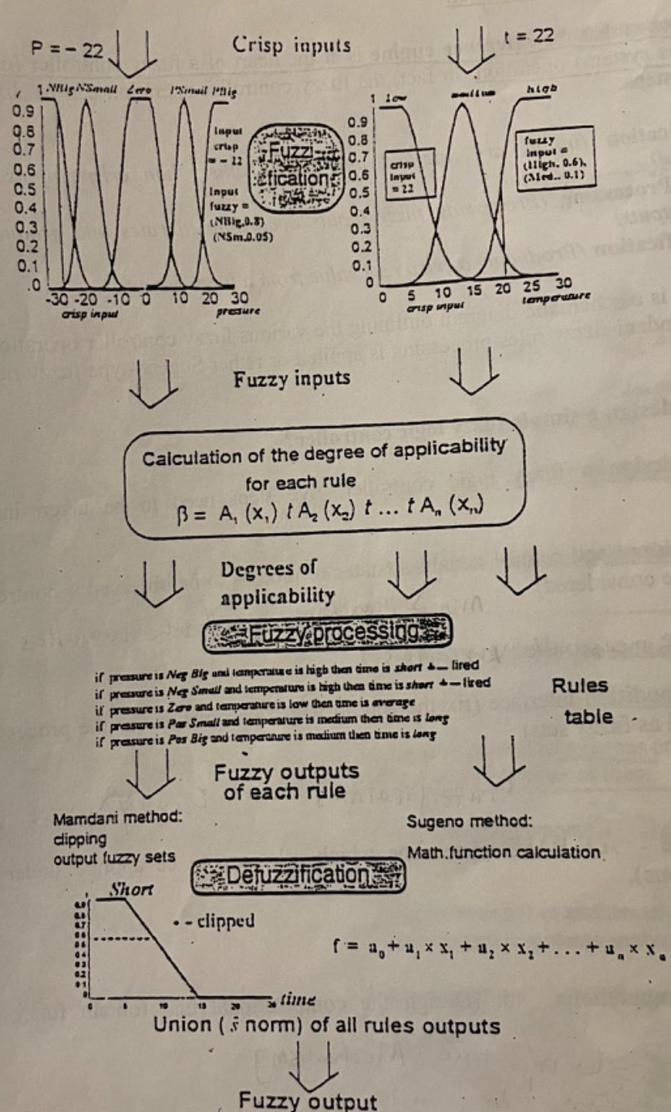
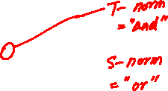
Fuzzy Rule Based System Operation
How to Design a Simple Fuzzy Rule Based System
The figure shows a schematic diagram outlining the various fuzzy rule based systems operations, whether Mamdani fuzzy rule processing is applied or rather Sugeno-type fuzzy rules processing.

Slide 25
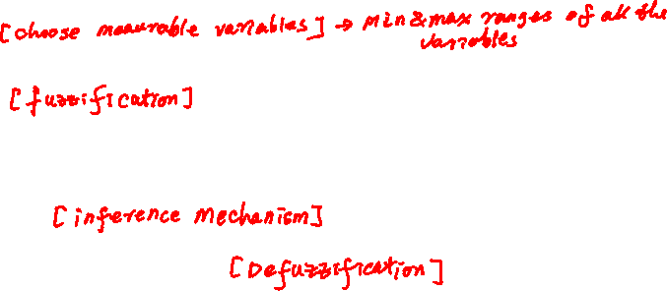
Fuzzy Rule Based System Operation
How to Design a Simple Fuzzy Rule Based System
In order to design a fuzzy rule based system, five steps need to be taken into consideration:
Step 1: Define the input and output variables (features/states of the system/process to be observed + outputs/control actions to be considered).
Step 2: Define the condition interface (fix the way in which observations of the system/process are expressed as fuzzy sets).
Step 3: Design the rule base (determine which rules are to be applied under which conditions)
Step 4: Design the computational unit (design the computational unit to obtain fuzzy outputs).
Step 5: Determine rules according to which fuzzy statements can be transformed into crisp control actions.

Slide 26
Fuzzy Rule Based System Operation
How to Design a Simple Fuzzy Rule Based System
Step 3 is at the heart of the fuzzy rule base design! To design the rule base, those rules can be obtained through:
an expert: his/her understanding of the system/process under investigation.
historical data: rules will be automatically elicited/learnt from data.
We will first look into how to building a fuzzy rule based system through experts in this lecture, and leave the rule elicitation to Week 11.

Slide 27
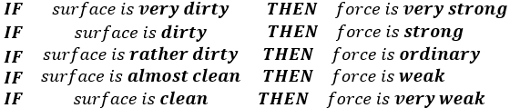
Fuzzy Rule Based System Operation
  An Example for Building a Fuzzy Expert System
A fuzzy vacuum cleaner should regulate the force of sucking dust from a surface being cleaned.
The input of this fuzzy vacuum cleaner should consider the amount of dust on the surface which can be
Very dirty, Dirty, Rather dirty, Almost clean, Clean
The force of sucking dust can be described as linguistic variables with values of
Very strong, Strong, Ordinary, Weak, Very weak
The fuzzy vacuum cleaner should be able to change the force depending on how dirty the surface is. Hence, as the first attempt, we may have the following fuzzy rule based system as the fuzzy vacuum cleaner.

Slide 28
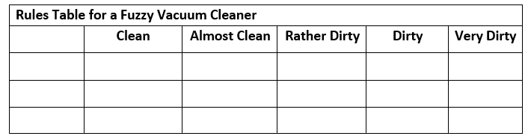

Fuzzy Rule Based System Operation
  An Example for Building a Fuzzy Expert System
Example 6
Can this fuzzy vacuum cleaner be improved by adding extra knowledge of vacuum cleaning process?
Solution
A fuzzy vacuum cleaner like the above has been implemented firstly in a Japanese manufactured vacuum cleaner. Similar systems like this has been widely used in context-aware smart products, like iRobot (https://www.irobot.com/) that allows users to hack the system for further development (see [2]).

Slide 29
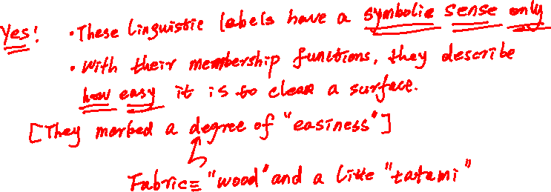
Fuzzy Rule Based System Operation
  An Example for Building a Fuzzy Expert System
Example 7
Would this controller work on a different surface, like linen fabric surface? How is this vacuum cleaner implemented practically?
Solution

Slide 30


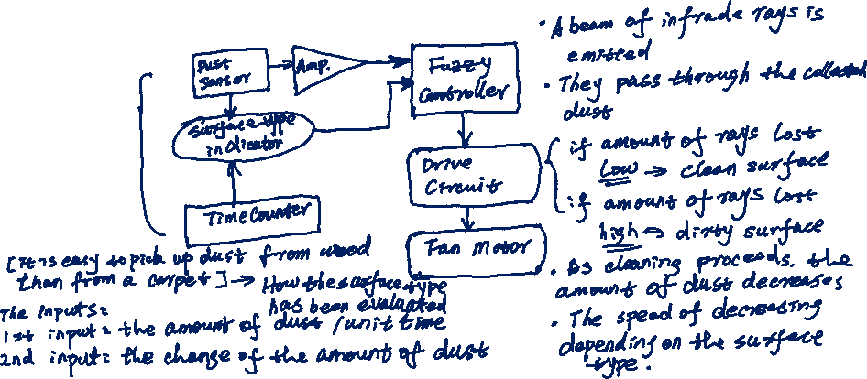
Fuzzy Rule Based System Operation
  An Example for Building a Fuzzy Expert System
Example 7 Continued…
Solution

Slide 31
End slide

